Slide 1

Stress-Induced Mutagenesis: Evolutionary perspective
Yoav Ram
Hadany Lab
Tel-Aviv University
16 June 2016

Slide 2



Variability in mutation rates
Between species
Rates are in average number of measurable mutations per genome per generation
Flies: 0.455
Keightley et al. Gen Res 2009
Humans: 41
Lynch, PNAS 2010
Bacteria: 0.0004
Wielgoss et al. G3 2011

Slide 3
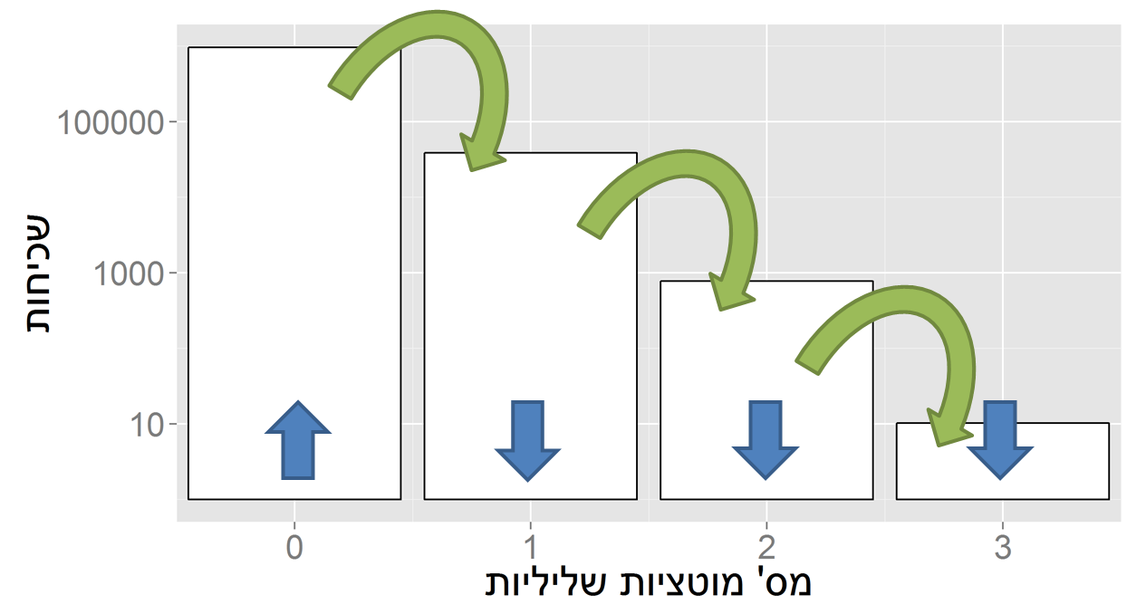
Evolution in constant environments
Directional selection without change
A balance between mutation and natural selection
Frequency
# Deleterious mutations

Slide 4
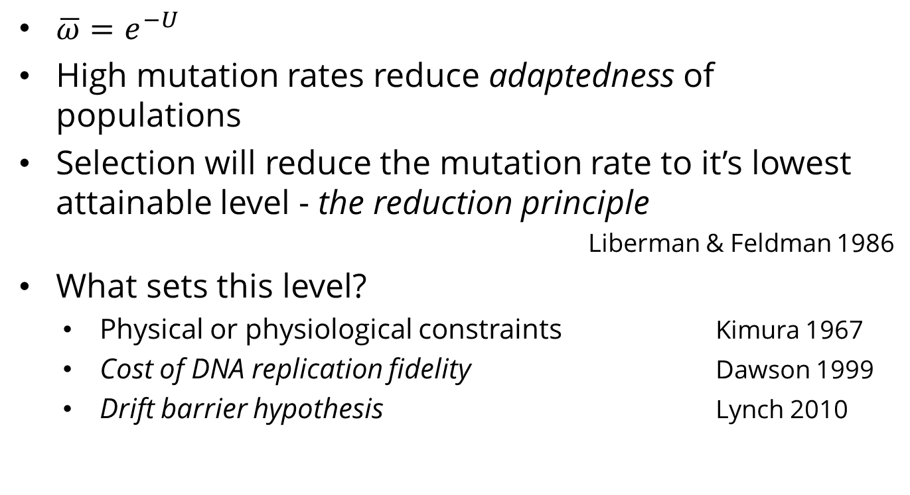
Mutation rate in constant environments
$\overline{ω}=e^{−U}$
High mutation rates reduce adaptedness of populations
Selection will reduce the mutation rate to it’s lowest attainable level - the reduction principle
Liberman & Feldman 1986
What sets this level?
Physical or physiological constraints Kimura 1967
Cost of DNA replication fidelity Dawson 1999
Drift barrier hypothesis Lynch 2010

Slide 5

Changing environments
In changing environments rapid adaptation can be favored by natural selection (adaptability)
The mutation rate must balance between adaptability and adaptedness
Leigh 1973
Shujun Wong 2009

Slide 6

Variability in mutation rates
Within species
Mutation rate in 69 natural populations of E. coli
Matic et al. 1997

Slide 7
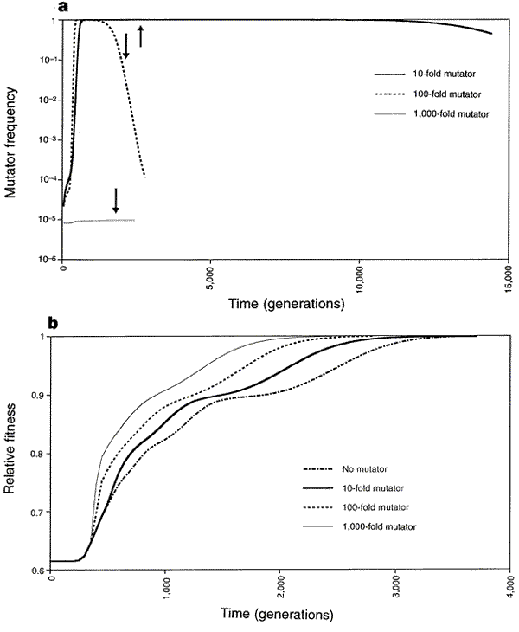
Adaptation with mutator alleles
x100
x10
x1
x1,000
Taddei et al. Nature 1997

Slide 8
Rise and fall of the mutator allele
x10
x100
x1,000
Taddei et al. Nature 1997
Notes:
An arrow symbolizes the time when population fitness has reached 0.99

Slide 9

Variability in mutation rates
Within individuals
DNA polymerase error rate Lynch 2011

Slide 10

Stress-induced mutation
Rosenberg et al. 2012
In E. coli:
Error prone polymerase induced by stress responses:
SOS response
DNA damage
Starvation
Mismatch repair system
Other mechanisms:
Galhardo et al. 2007
Al Mamun, Science 2012

Slide 11

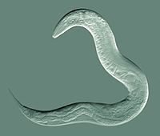
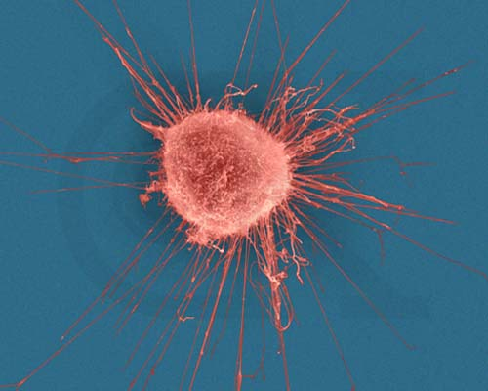



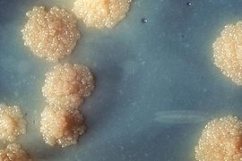

Evidence
Green algea
Nematodes
E. coli
Bacillus subtilis
Breast cancer cell
D. Melanogaster
M. tuberculosis
L. monocytogenes

Slide 12

Evolution of stress-induced mutation
Null hypothesis
Mutagenesis is the by-product of stress
Alternative non-adaptive hypotheses
Cost of replication fidelity
Drift barrier hypothesis
Adaptive hypothesis
2nd order selection

Slide 13
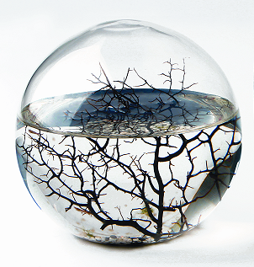
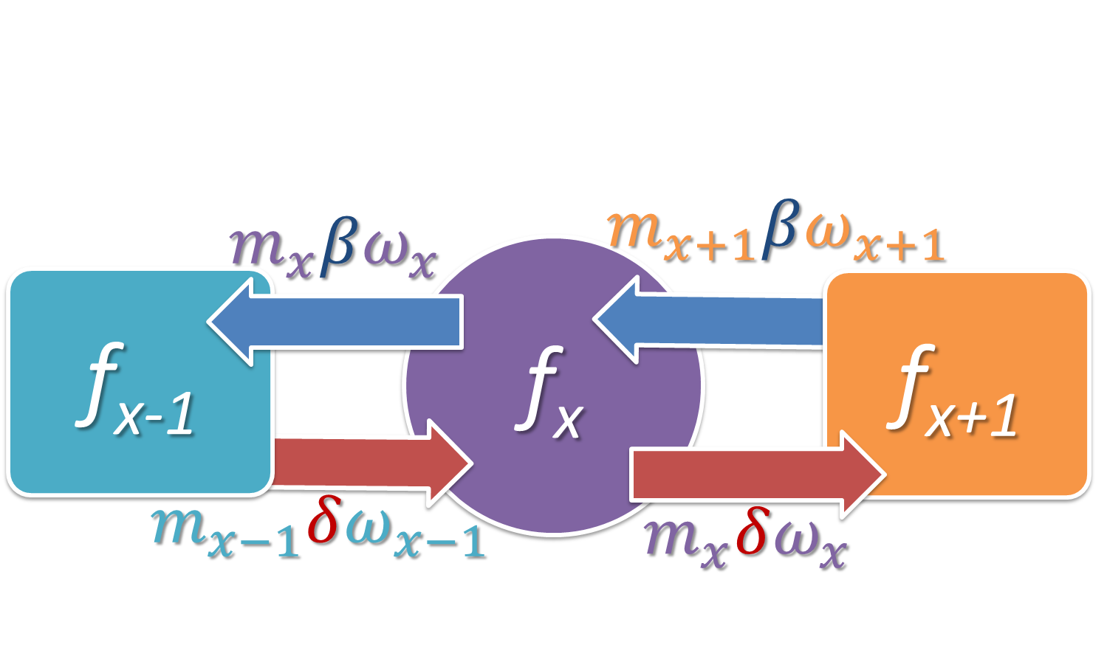
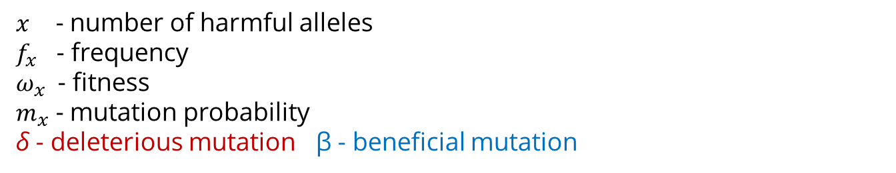
Constant environment
Selection against generation of deleterious mutations
$x$ - number of harmful alleles
$f_{x}$ - frequency
$ω_{x}$ - fitness
$m_{x}$ - mutation probability
δ - deleterious mutation β - beneficial mutation
Ram & Hadany, Evolution 2012

Slide 14
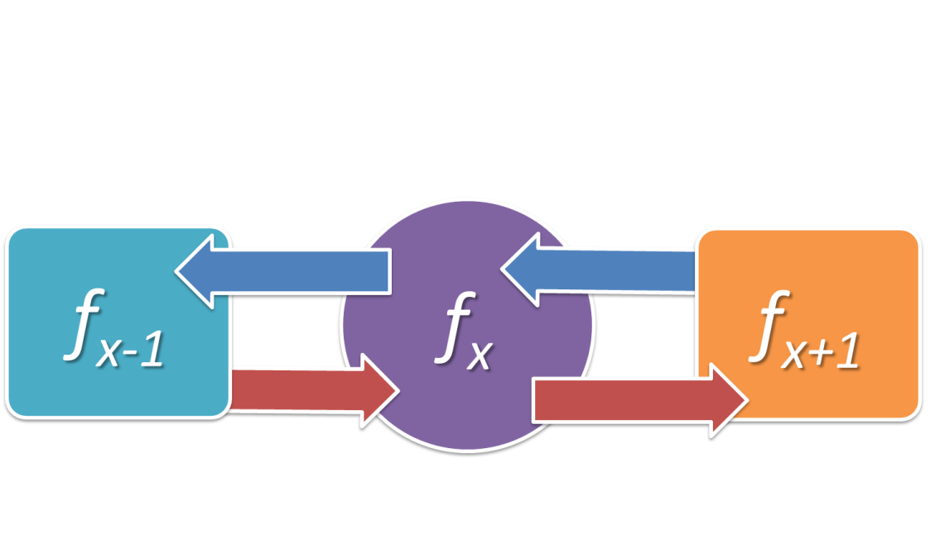
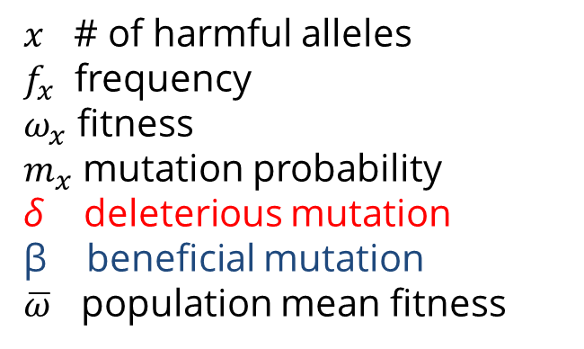
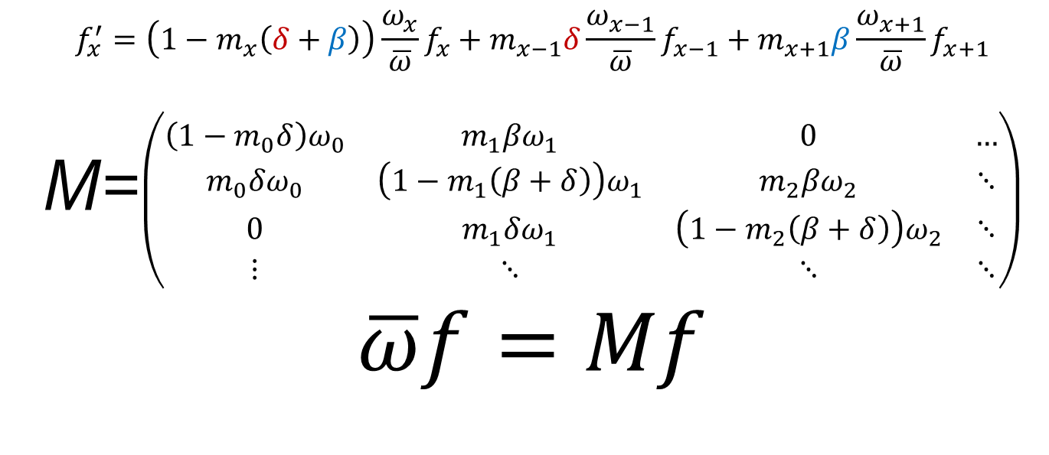
$x$ # of harmful alleles
$f_{x}$ frequency
$ω_{x}$ fitness
$m_{x}$ mutation probability
δ deleterious mutation
β beneficial mutation
$\overline{ω}$ population mean fitness
$$f_{x}^{′}=\left(1−m_{x}\left(δ+β\right)\right)\frac{ω_{x}}{\overline{ω}}f_{x}+m_{x−1}δ\frac{ω_{x−1}}{\overline{ω}}f_{x−1}+m_{x+1}β\frac{ω_{x+1}}{\overline{ω}}f_{x+1}$$
M=$\left(\begin{matrix}\left(1−m_{0}δ\right)ω_{0} & m_{1}βω_{1} & 0 & … \\ m_{0}δω_{0} & \left(1−m_{1}\left(β+δ\right)\right)ω_{1} & m_{2}βω_{2} & ⋱ \\ 0 & m_{1}δω_{1} & \left(1−m_{2}\left(β+δ\right)\right)ω_{2} & ⋱ \\ ⋮ & ⋱ & ⋱ & ⋱\end{matrix}\right)$
$$\overline{ω}f=Mf$$
Ram & Hadany, Evolution 2012

Slide 15
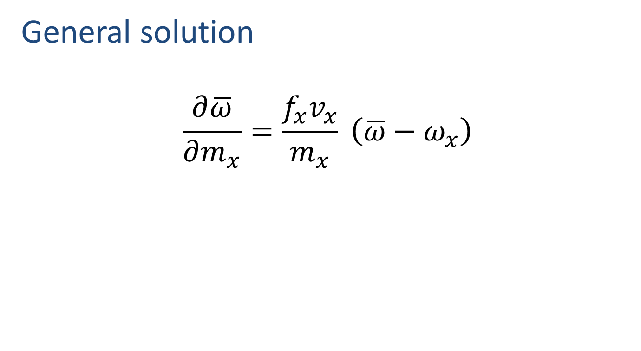
Constant environment
General solution
$$\frac{∂\overline{ω}}{∂m_{x}}=\frac{f_{x}v_{x}}{m_{x}} \left(\overline{ω}−ω_{x}\right)$$
Ram & Hadany, Evolution 2012

Slide 16
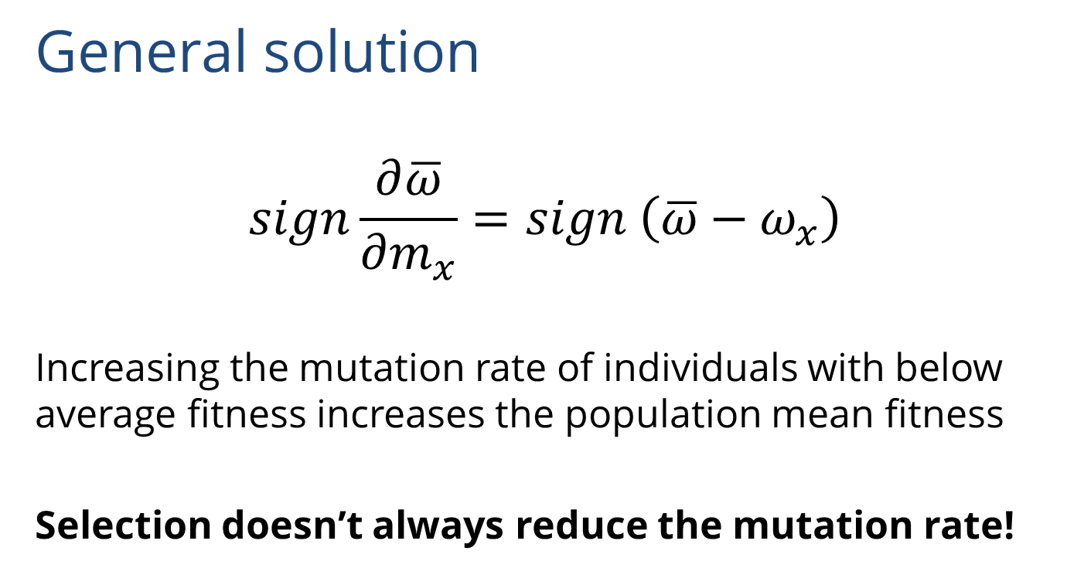
Constant environment
General solution
$$sign\frac{∂\overline{ω}}{∂m_{x}}=sign \left(\overline{ω}−ω_{x}\right)$$
Increasing the mutation rate of individuals with below average fitness increases the population mean fitness
Selection doesn’t always reduce the mutation rate!
Ram & Hadany, Evolution 2012

Slide 17

Constant environment
Constitutive mutator (CM)
Ram & Hadany, Evolution 2012

Slide 18

Constant environment
Stress-induced mutator (SIM)
No beneficial mutations
Ram & Hadany, Evolution 2012

Slide 19

Changing environments
The Red Queen hypothesis:
van Valen, 1973
It takes all the running you can do, to keep in the same place.
- Lewis Carrol, Through the Looking Glass

Slide 20

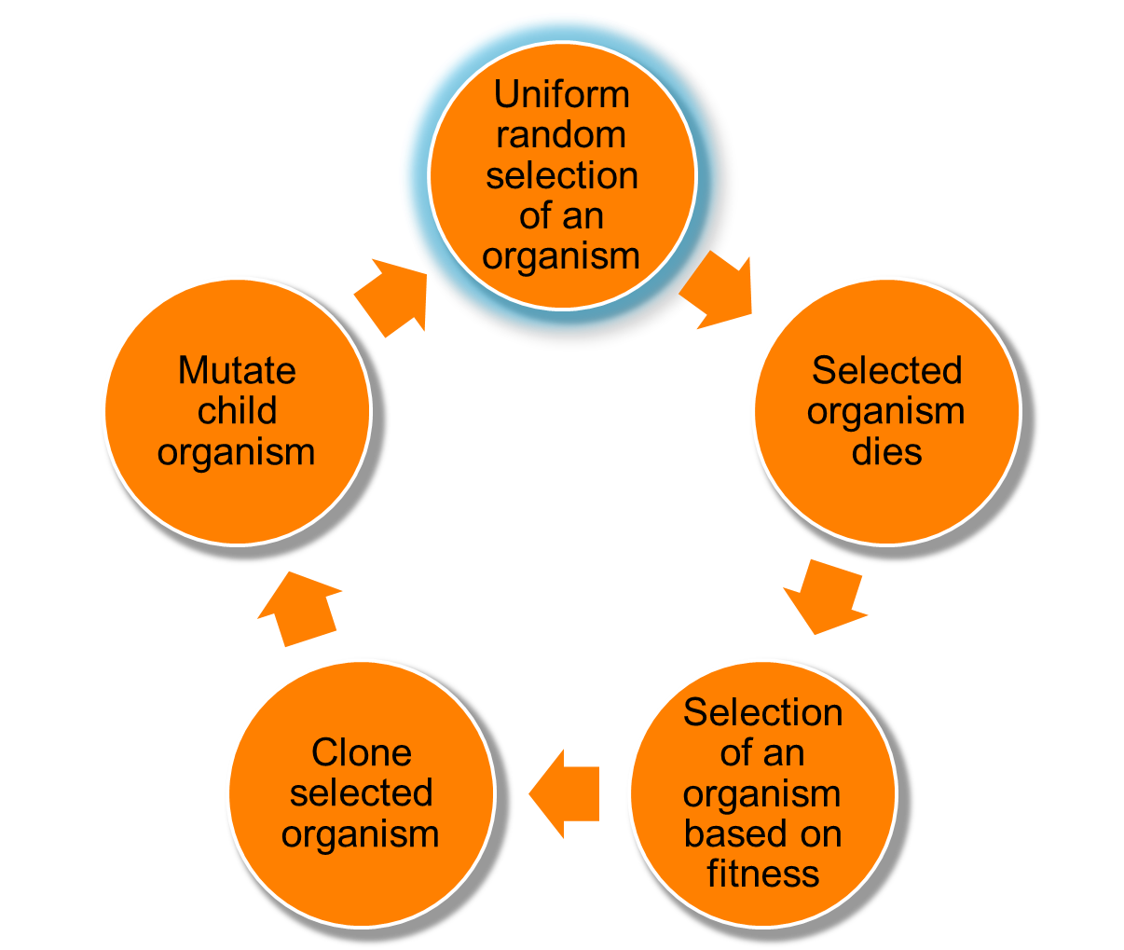
Changing environments
https://github.com/yoavram/proevolutionsimulation
Simulations
Moran process
Individual-based simulations
100,000 individuals
1,000 loci
Asexual, Haploid
Overlapping generations
No recombination
No segregation
No mutations at mutator locus
Environmental changes
Ram & Hadany, Evolution 2012

Slide 21
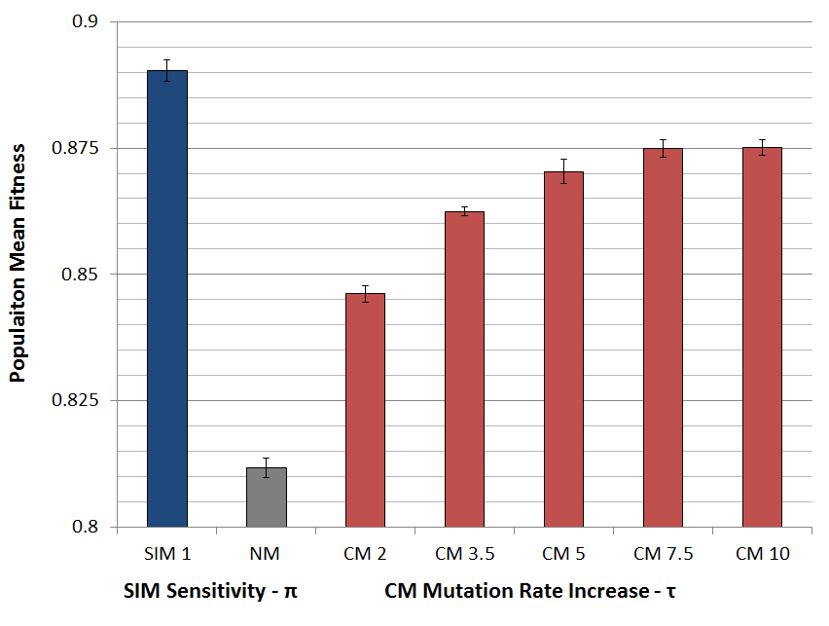
Populations with SIM are fitter
Ram & Hadany, Evolution 2012

Slide 22

SIM wins competitions
Ram & Hadany, Evolution 2012

Slide 23

SIM wins competitions
Ram & Hadany, Evolution 2012

Slide 24
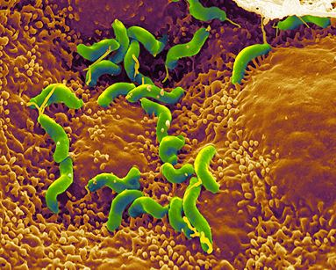
Summary: Evolution of stress-induced mutation
Stress-induced mutators evolve:
In finite & infinite populations
In constant & changing environments
2nd order selection can lead to the evolution of stress-induced mutagenesis in asexual populations
Selection for evolvability
H. pylori

Slide 25
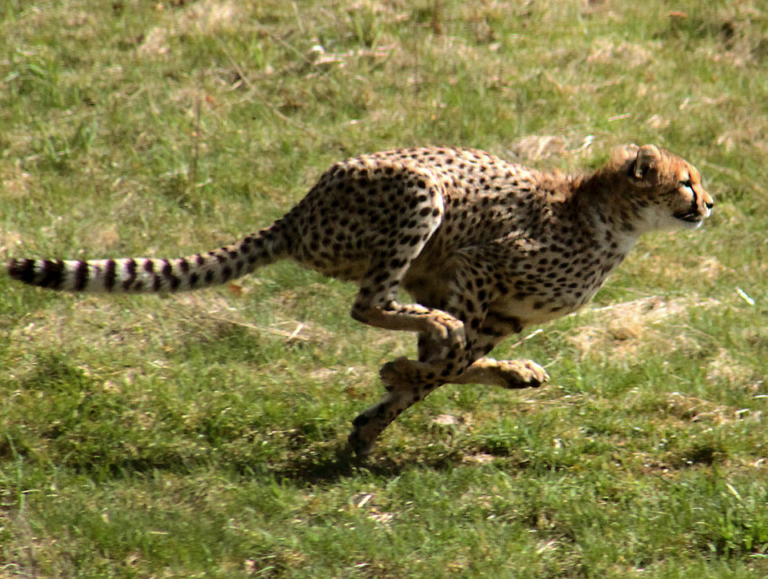
Consequences of Stress-Induced Mutagenesis
Can SIM make adaptation faster?
Malene Thyssen

Slide 26
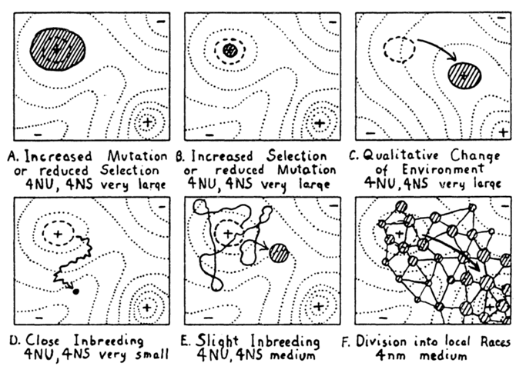
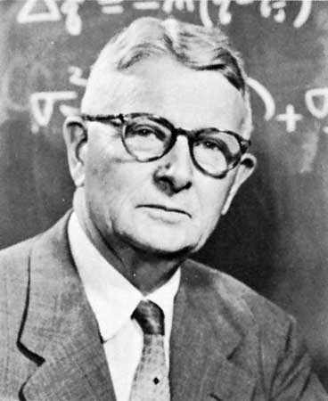
Adaptive peak shifts
Sewall Wright, 1931:
If a new adaptation requires several, separately deleterious mutations, how can it evolve?
Wright, Am. Nat. 1988

Slide 27
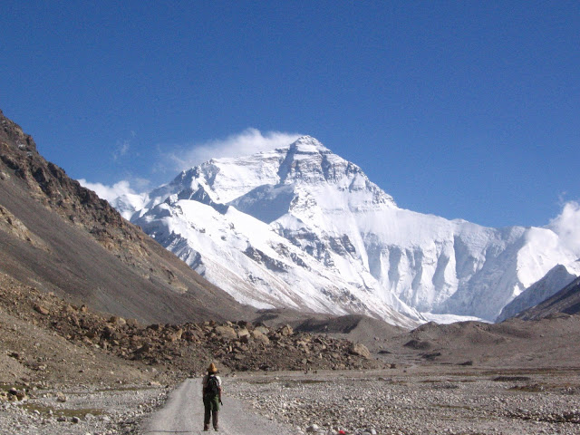
Simple landscape

Slide 28
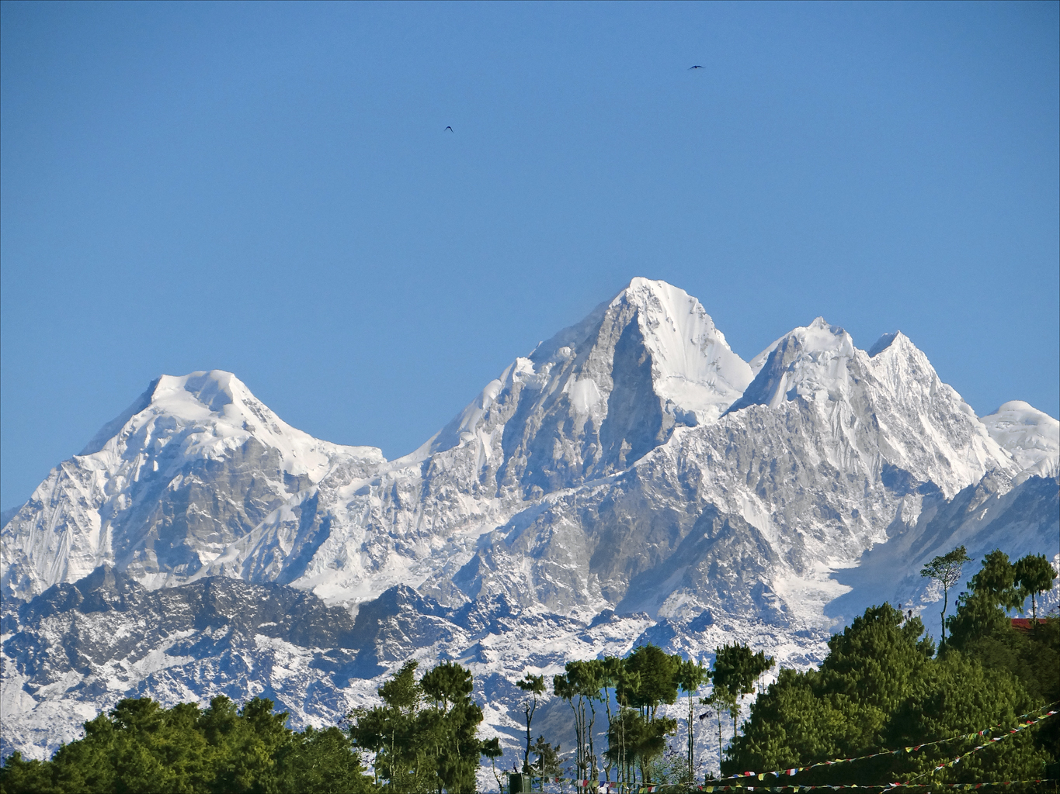
Rugged landscape

Slide 29
Adaptive peak shift

Slide 30
SIM & rugged landscapes
Increasing the mutation rate in individuals below both peaks
High mutation rate
Low mutation rate

Slide 31
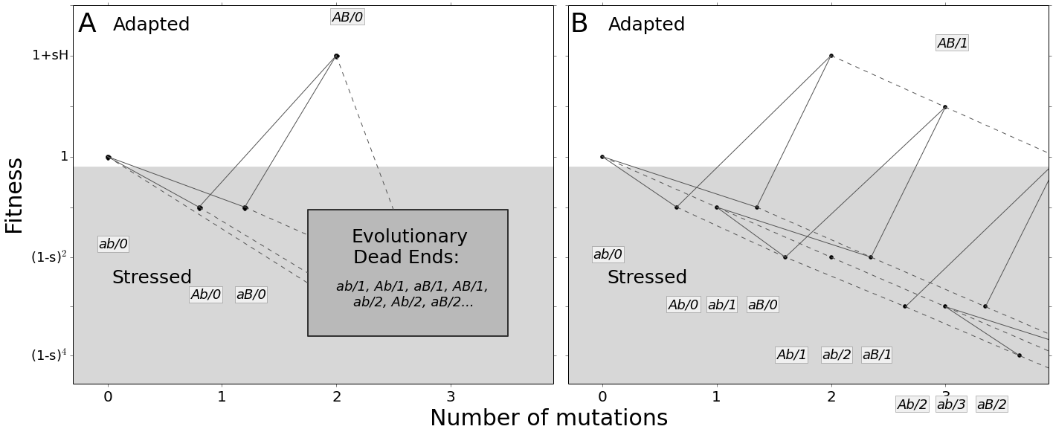
Deterministic model
Ram & Hadany, PRSB 2014

Slide 32
Deterministic model
The adaptation process is composed of
Waiting for the double mutant to appear
Fixation / extinction of the double mutant

Slide 33
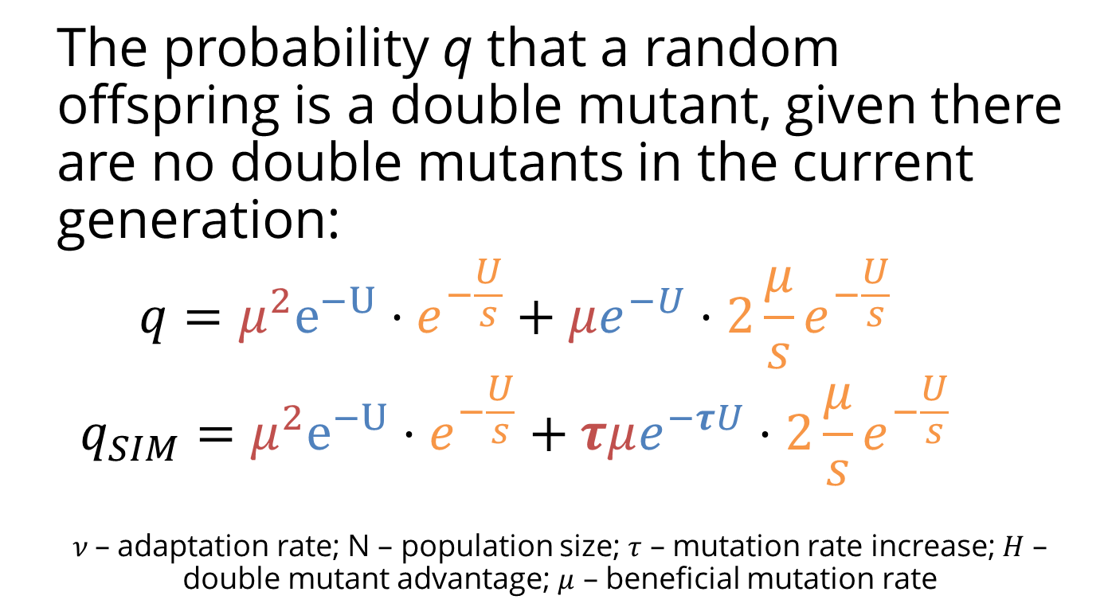
Deterministic model
The probability q that a random offspring is a double mutant, given there are no double mutants in the current generation:
$$q=μ^{2}e^{−U}⋅e^{−\frac{U}{s}}+μe^{−U}⋅2\frac{μ}{s}e^{−\frac{U}{s}}$$
$$q_{SIM}=μ^{2}e^{−U}⋅e^{−\frac{U}{s}}+τμe^{−τU}⋅2\frac{μ}{s}e^{−\frac{U}{s}}$$
$ν$– adaptation rate; N – population size; $τ$ – mutation rate increase; $H$ – double mutant advantage; $μ$ – beneficial mutation rate
Ram & Hadany, PRSB 2014

Slide 34
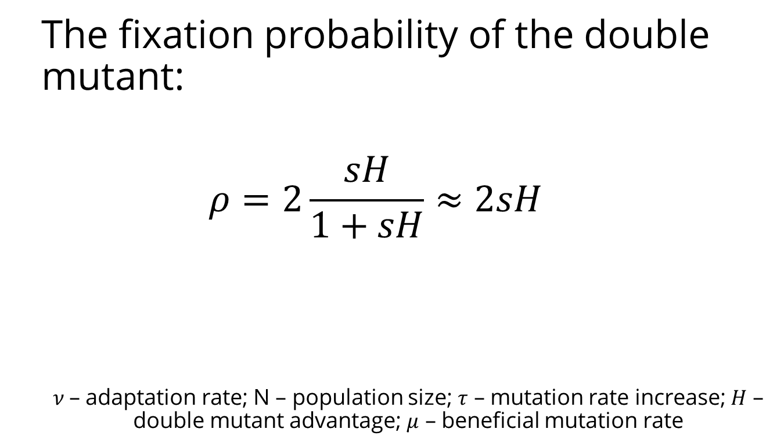
Deterministic model
The fixation probability of the double mutant:
$$ρ=2\frac{sH}{1+sH}≈2sH$$
$ν$– adaptation rate; N – population size; $τ$ – mutation rate increase; $H$ – double mutant advantage; $μ$ – beneficial mutation rate
Eshel 1981
Ram & Hadany, PRSB 2014

Slide 35
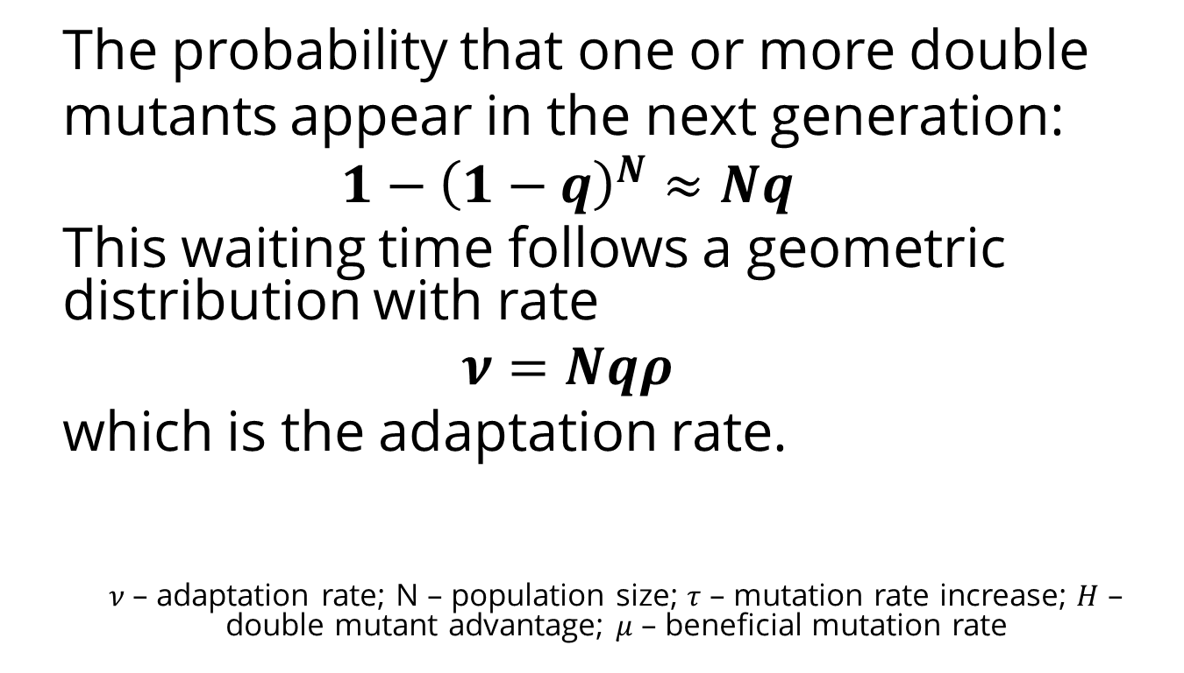
Deterministic model
The probability that one or more double
mutants appear in the next generation:
$$1−{\left(1−q\right)}^{N}≈Nq$$
This waiting time follows a geometric distribution with rate
$$ν=Nqρ$$
which is the adaptation rate.
$ν$– adaptation rate; N – population size; $τ$ – mutation rate increase; $H$ – double mutant advantage; $μ$ – beneficial mutation rate
Ram & Hadany, PRSB 2014

Slide 36
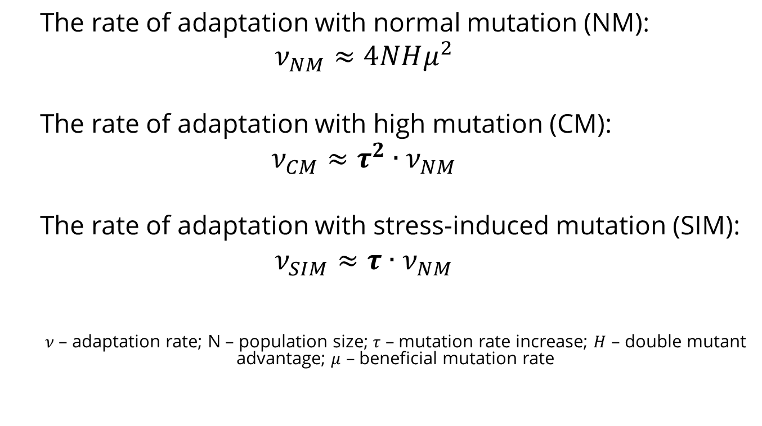
Deterministic results
The rate of adaptation with normal mutation (NM):
$$ν_{NM}≈4NHμ^{2}$$
The rate of adaptation with high mutation (CM):
$$ν_{CM}≈τ^{2}∙ν_{NM}$$
The rate of adaptation with stress-induced mutation (SIM):
$$ν_{SIM}≈τ∙ν_{NM}$$
$ν$– adaptation rate; N – population size; $τ$ – mutation rate increase; $H$ – double mutant advantage; $μ$ – beneficial mutation rate
Ram & Hadany, PRSB 2014

Slide 37
Stochastic model
https://github.com/yoavram/ruggedsim
No MSB assumption
No Dead Ends
Genetic drift
Ram & Hadany, PRSB 2014

Slide 38
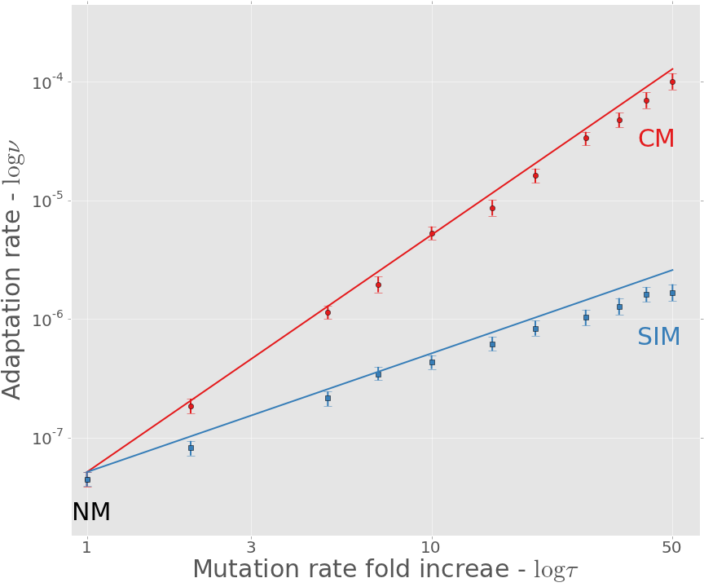
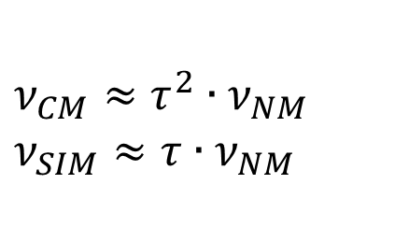
Adaptation rate
https://github.com/yoavram/ruggedsim
$$ν_{CM}≈τ^{2}∙ν_{NM}$$
$$ν_{SIM}≈τ∙ν_{NM}$$
Approximation
Simulation
Ram & Hadany, PRSB 2014

Slide 39
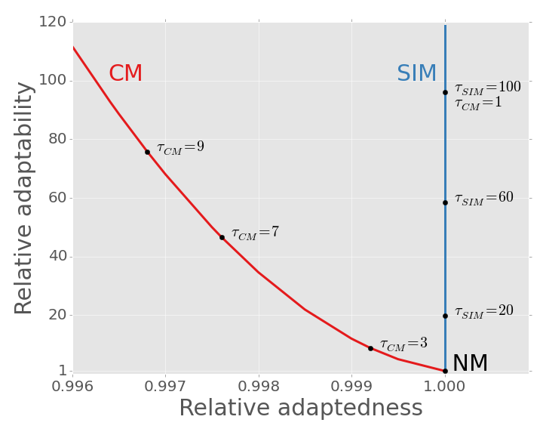
SIM Breaks the adaptability-adaptedness trade-off
Ram & Hadany, PRSB 2014

Slide 40
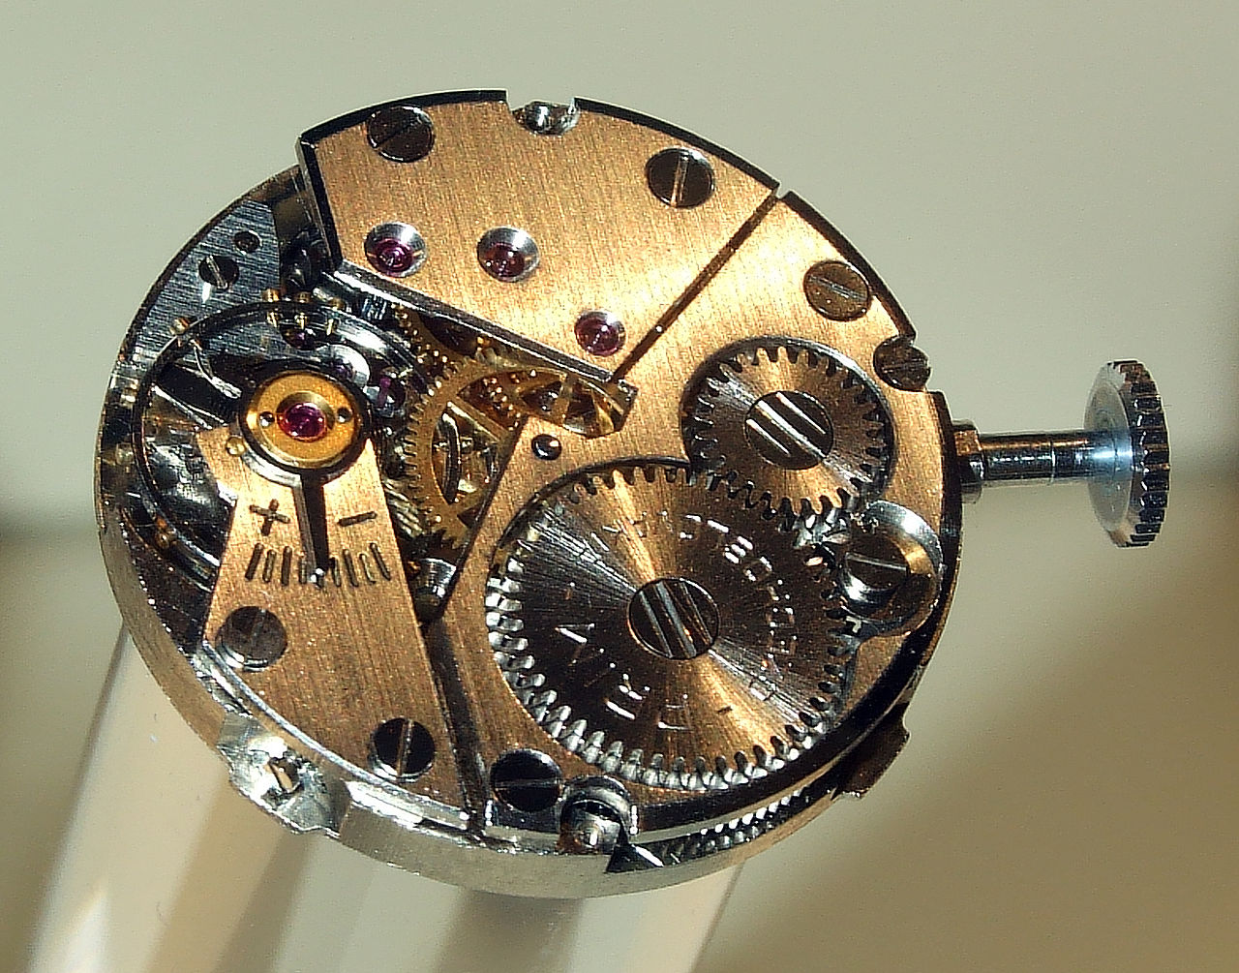
Future directions

Slide 41
In the presence of rare recombination
Recombination can:
Separate mutator from beneficial mutations
Increase non-mutator adaptation rate
Save constitutive mutators from deleterious mutations

Slide 42
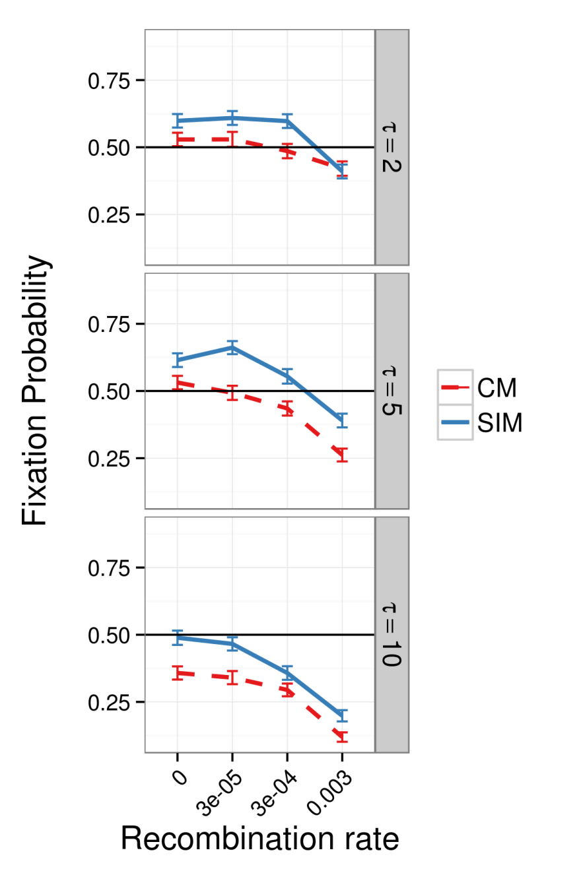
In the presence of rare recombination
Results suggest:
SIM > CM
SIM >= NM
As long as recombination is as not much stronger than mutation
Sexual populations??
Ram & Hadany, in preparation

Slide 43
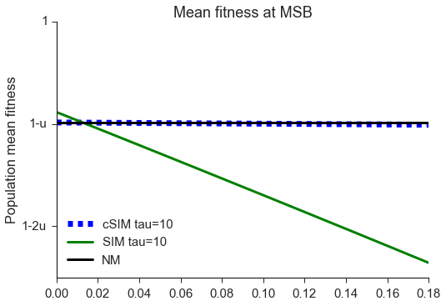
Stress-induced mutagenesis under uncertainty
Uncertainty
should you mutate?
SIM decreases mean fitness
Communication
Increase in mutation rate depends on population mean fitness
Robustness to uncertainty
Uncertainty level
Gur-Dellus, Ram & Hadany, in preparation

Slide 44
Conclusions
Evolution of stress-induced mutagenesis:
SIM can evolve due to 2nd order selection
In constant and changing environments
Ram & Hadany, Evolution 2012
In the presence of rare recombination
Effects of stress-induced mutagenesis:
SIM increases the adaptation rate without reducing the population mean fitness
Breaks the trade-off between adaptability and adaptedness
Ram & Hadany, PRSB 2014

Slide 45




yoav@yoavram.com
@yoavram
github.com/yoavram
www.yoavram.com
a

